Slide 1
Customer Retention

Slide 2
E-retail Factors FOR CUSTOMER ACTIVATION & RETENTION
Dataset have 269 Rows and 71columns.
There are no null-values for any columns.
All the columns are of object datatype except for pincode column which is of int type.

Slide 3
Uvivarient Analysis
Doing analysis of personal-info containing columns using graphical view.
From analysis,
There is double the number of women than men who have taken this survey.
Most of the people are in their 30's followed by 20's, teenagers and senior citizen are the least in number.

Slide 4
Most of the people belong from delhi, noida and banglore, ambiguity can also be seen as noida has two categories (noida and grater noida) which need to be handled
Most of the people shopping online have been shopping from a long time.
Majority of people shop online 10 times a year, amiguity can also be seen for range 42 times and above which needs to be handled

Slide 5
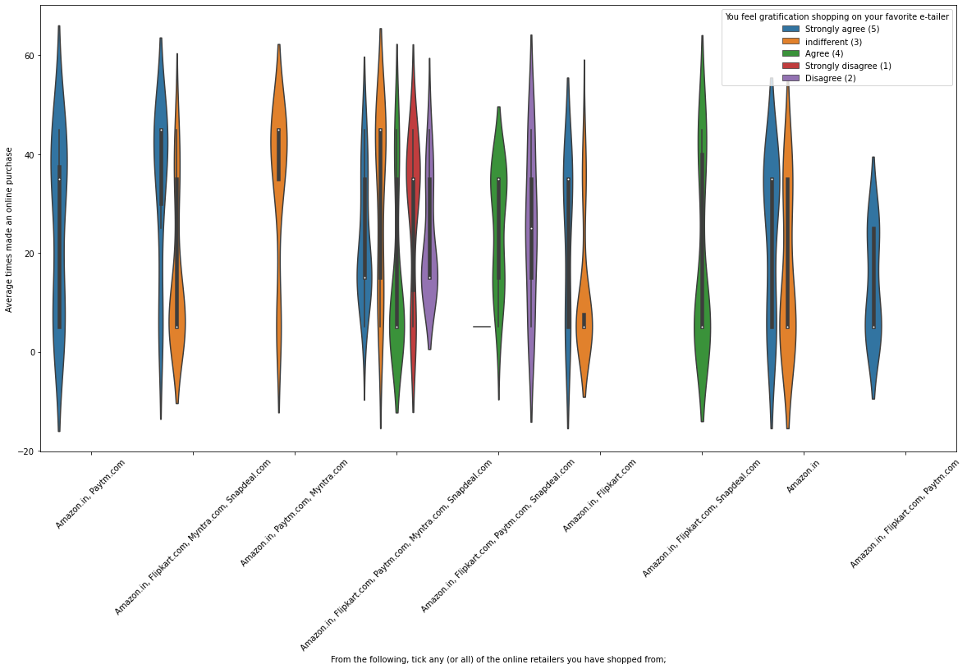

Slide 6
Analysis on the basis various factors
Intention of Repeat purchase
Heavy shoppers who shop more than 41 times a year shop from all the online brands, some of the people who shop for 32-40 and less than 10 times a year seem to exclude myntra. People shop from Amazon and flipkart whatever be the case.
Almost all the people who have shopped from amazon, flipkart and paytm are satisfied. People who shop from a more number of online brands dosent seem to be satisfied.

Slide 7
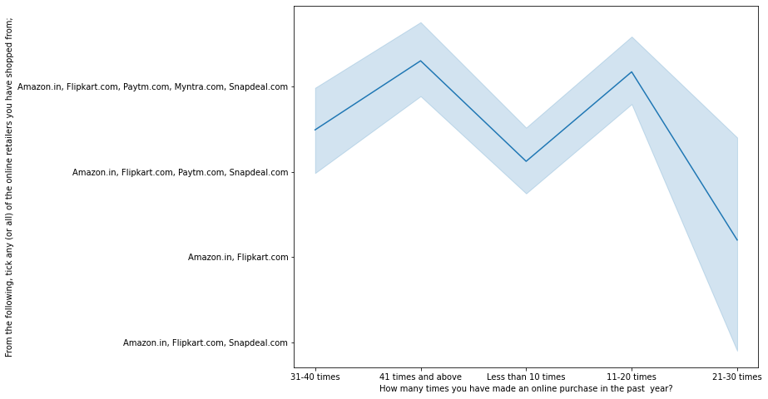

Slide 9
People shopping from amazon and paytm are getting benefits from the loyalty points, flipkart and sanpdeal also seem to give such benefits but people who shop from almost everywhere disagree with this statement too

Slide 10
Online retailing
Highest number of people have been shopping online for above 4 years except for the age group below 20 years and above 50 years. People who are shopping online for 1-2 years does not include teenagers and elder people.
From grapth we can see that density of female customers is more than male. Men living in banglore and ghaziabad shop have shopped online for less than 1 year. Highest number of men shopping online belong from delhi and noida, while men from moradabad have been shopping online for the longest. Women from meerut and noida have shopped the longest.

Slide 11
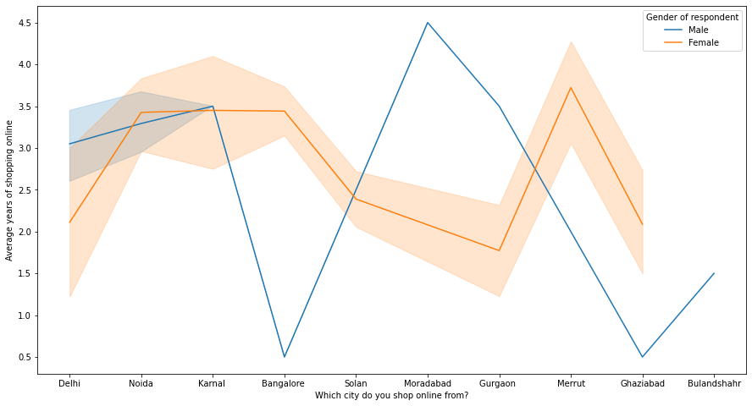
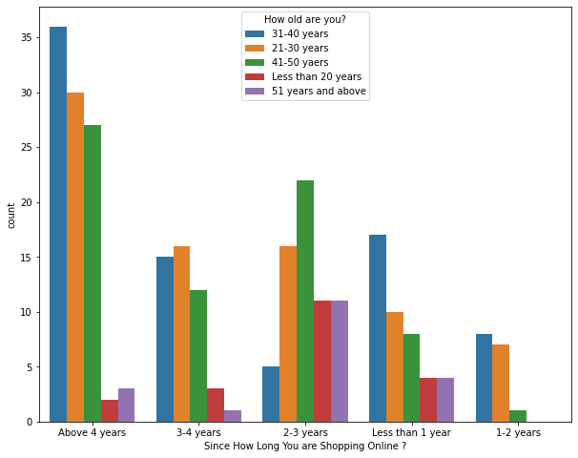
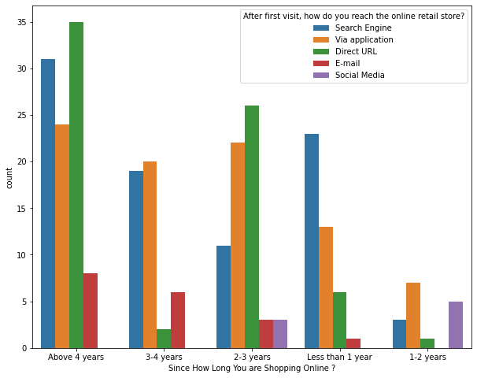

Slide 12
Even though people who are shopping online for more than 3 years donot use the application rather use search engine and direct url's in large number which indicates that online brands should update all their platforms rather than just application.

Slide 13
Conclusion
The cost of the product, the reliability of the E-commerce company and the return policies all play an equally important role in deciding the buying behaviour of online customers. The cost is an important factor as it was the basic criteria used by online retailers to attract customers. The reliability of the E-commerce company is also important, as it is even required in offline retail. It is important because customers are paying online, so they need to be sure of security of the online transaction. The return policies are important because in online retail customer does not get to feel the product. Thus, he wants to be sure that it will be possible to return the product if he does not like it in real. Whereas, the logistics factor, which included Cash on delivery option, One day delivery and the quality of packaging plays a secondary role in this process though these are Must-be-quality. This is so because these all does not interfere with the real product and people believe that this is the basic value that E-commerce websites provide.

Slide 14
All the websites were not equally preferred by online customers. Amazon was the most preferred followed by Flipkart. This can be explained easily by previous result that we got. These two companies are most trusted in the industry and hence, have a huge reliability. Also, the sellers listed on these websites are generally from Tier 1 cities as compared to Snapdeal and PayTM which have more sellers from tier 2 and 3 cities. Also, these websites have the most lenient return policies as compared to others and also the time required to process a return is low for these

